Slide 1
Computer viruses and its types

Slide 2
No one enjoys being sick. When you’re suffering from a cold, there’s no way you can operate at 100%
It might sound silly, but your computer can catch a cold just like you. OK, maybe not exactly like you—you won’t give your computer a virus by sneezing on your keyboard, but there are similarities.
Computer viruses have the “virus” name because they resemble illnesses in the way they infect a system. Doctors can usually diagnose a virus based on symptoms exhibited by the body. IT professionals can do the same with computers.

Slide 3
Common Signs of Computer Viruses
1. Speed of system/Slow performance
2. Pop-up windows/Constant browser pop-ups
3. Programs self-executing
4. Accounts being logged out
5. Crashing of the device
6. Mass emails being sent from your email account
7. Changes to your homepage
Missing files
Low storage
Unidentifiable programs
Increased network activity
Disabled security software
Notes:
A computer system running slower than usual is one of the most common signs that the device has a virus. This includes the system itself running slowly, as well as applications and internet speed suffering. If a computer does not have powerful applications or programs installed and is running slowly, then it may be a sign it is infected with a virus.
2. Pop-up windows
Unwanted pop-up windows appearing on a computer or in a web browser are a telltale sign of a computer virus. Unwanted pop-ups are a sign of malware, viruses, or spyware affecting a device
3. Programs self-executing
If computer programs unexpectedly close by themselves, then it is highly likely that the software has been infected with some form of virus or malware. Another indicator of a virus is when applications fail to load when selected from the Start menu or their desktop icon. Every time that happens, your next step should be to perform a virus scan and remove any files on programs that might not be safe to use.
4. Accounts being logged out
Some viruses are designed to affect specific applications, which will either cause them to crash or force the user to automatically log out of the service.
5. Crashing of the device
System crashes and the computer itself unexpectedly closing down are common indicators of a virus. Computer viruses cause computers to act in a variety of strange ways, which may include opening files by themselves, displaying unusual error messages, or clicking keys at random.
6. Mass emails being sent from your email account
Computer viruses are commonly spread via email. Hackers can use other people's email accounts to spread malware and carry out wider cyberattacks. Therefore, if an email account has sent emails in the outbox that a user did not send, then this could be a sign of a computer virus.
7. Changes to your homepage
Any unexpected changes to a computer—such as your system’s homepage being amended or any browser settings being updated—are signs that a computer virus may be present on the device.

Slide 4
Common Signs of Computer Viruses
Opening of Pop-up window frequently. Pop-ups may entice you to visit odd locations. They will take you to a page to download any antivirus (which is actually not an antivirus), or other harmful software.
Updated homepage. For example, the homepage is replaced by a website and you would not be able to undo that replacement.
Identifying that your files are corrupted.
Change in the name of your hard drive & also change in its volume.
Change in amount of free memory available.
Not able to find your files or programs.
Unknown change in the password that does not let you login.
A virus may damage your hard drive and our device may freeze or crash as a result of this.

Slide 5
How Do You Catch Computer Viruses?
Most people know how to prepare for cold and flu season: wash your hands, cover your mouth when you cough, cover your nose when you sneeze, get plenty of rest, and avoid people who might be sick. It’s something we learn from a young age.
We know to take these precautions, because we know how humans contract viruses. In the same vein, when you understand how viruses infect computers, you can take better preventative measures to prevent viruses and identify a virus before it rages out of control.

Slide 6
Where Does Malware Come From?
Malware can originate from various sources, such as:
Phishing emails
Malicious websites
Torrents
Shared networks

Slide 7
What is computer virus
A computer virus is a type of malicious software, or malware, that infects computers and corrupts their data and software.
They are always the result of human activity. Because they are designed to replicate themselves by infecting other programs on a computer, they are termed "viruses".
Computer viruses are designed to cause system disruption, significant operational issues, and data loss and leakage.
They typically attach to an executable host file, resulting in the execution of their viral code when a file is opened. The code then spreads via networks, drives, file-sharing programs, or infected email attachments from the document or software to which it is attached.
The way a computer virus performs is determined by the way it is coded. It could be as simple as a harmless prank, or it could be sophisticated, resulting in criminal activity and fraud.
While some viruses are limited to a single device, others spread across a network environment in search of other vulnerable hosts.

Slide 8
Viruses can find their way onto just about any device – from Windows PCs and Macs to iPhones and Androids.

Slide 9
How Do Computer Viruses Attack and Spread?
In the early days of computers, viruses were spread between devices using floppy disks. Nowadays, viruses can still be spread via hard disks and Universal Serial Bus (USB) devices, but they are more likely to be passed between devices through the internet.
Computer viruses can be spread via email, with some even capable of hijacking email software to spread themselves. Others may attach to legitimate software, within software packs, or infect code, and other viruses can be downloaded from compromised application stores and infected code repositories. A key feature of any computer virus is it requires a victim to execute its code or payload, which means the host application should be running.

Slide 10
How a Computer gets A Virus?
Through the following activities you may get your device infected by the virus :
Sharing the data like music, files, and images with each other.
If you open a spam email or an attachment in an email that is sent by an unknown person.
Downloading the free games, toolbars, media players, etc.
Visiting a malicious website.
Installing pirated software(s) etc.

Slide 11
Virus vs. malware vs. trojan vs. worm
Malware is a general term for malicious computer code.
A virus, is specifically a kind of malware that infects other applications and can only run when they run.
A worm is a malware program that can run, reproduce, and spread on its own.
Trojan is malware that tricks people into launching it by disguising itself as a useful program or document.

Slide 12
Malware
Malware, short for malicious software, encompasses a wide range of online threats designed to harm devices, networks, and users, often for the benefit of cybercriminals.
From computer viruses and trojan horses to ransomware and fileless malware, these insidious programs can infect devices through various means, including phishing emails, malicious downloads, and software vulnerabilities, leading to a potential malware attack.
The objectives of malware attacks are to exploit devices and networks for the detriment of the user and the advantage of the hacker, often resulting in data theft, system failures, or financial loss.

Slide 13
Related terms
Trojan: A Trojan horse is a type of program that pretends to be something it is not to get onto a device and infect it with malware. Therefore, a Trojan horse virus is a virus disguised to look like something it is not. For example, viruses can be hidden within unofficial games, applications, file-sharing sites, and bootlegged movies.
Worm: A computer worm is not a virus. Worms do not need a host system and can spread between systems and networks without user action, whereas a virus requires users to execute its code.
Ransomware: Ransomware is when attackers lock victims out of their system or files and demand a ransom to unlock access. Viruses can be used to carry out ransomware attacks.
Rootkit: A rootkit is not a virus. Rootkits are software packages that give attackers access to systems. They cannot self-replicate or spread across systems.
Software: "Bug" is a common word used to describe problems with computers, but a software bug is not a virus. A bug is a flaw or mistake in software code, which hackers can exploit to launch a cyberattack or spread malware.

Slide 14
What do computer viruses do?
Imagine an application on your computer has been infected by a virus.
The general course goes something like this: the infected application executes (usually at the request of the user), and the virus code is loaded into the CPU memory before any of the legitimate code executes.
At this point, the virus propagates itself by infecting other applications on the host computer, inserting its malicious code wherever it can.
A resident virus does this to programs as they open, whereas a non-resident virus can infect executable files even if they aren’t running.
Boot sector viruses use a particularly pernicious technique at this stage: they place their code in the boot sector of the computer’s system disk, ensuring that it will be executed even before the operating system fully loads, making it impossible to run the computer in a “clean” way.

Slide 15
What do computer viruses do? Contd..
Once the virus has its hooks into your computer, it can start executing its payload, which is the term for the part of the virus code that does the dirty work its creators built it for. These can include all sorts of nasty things: Viruses can scan your computer hard drive for banking credentials, log your keystrokes to steal passwords, turn your computer into a zombie that launches a DDoS attack against the hacker’s enemies, or even encrypt your data and demand a bitcoin ransom to restore access. (Other types of malware can have similar payloads.)

Slide 16
Types of Computer Viruses
Resident viruses infect programs that are currently executing.
Non-resident viruses, by contrast, can infect any executable code, even if it isn’t currently running
Boot sector viruses infect the sector of a computer’s startup disk that is read first, so it executes before anything else and is hard to get rid of
A macro virus infects macro applications embedded in Microsoft Office or PDF files. Many people who are careful about never opening strange applications forget that these sorts of documents can themselves contain executable code. Don’t let your guard down!
A polymorphic virus slightly changes its own source code each time it copies itself to avoid detection from antivirus software.
Web scripting viruses execute in JavaScript in the browser and try to infect the computer that way.

Slide 17
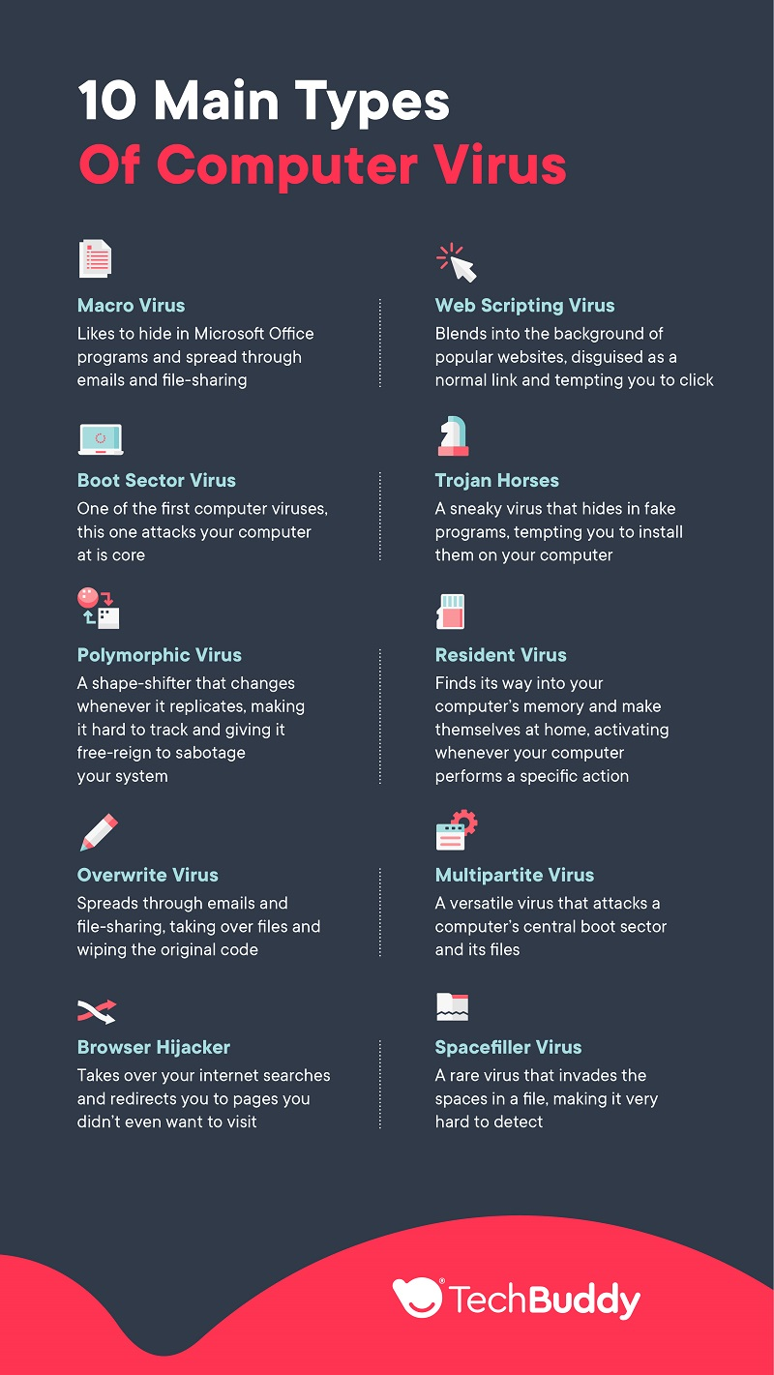
Types of computer viruses

Slide 18
Malware types
Viruses
Worms
Trojans
Ransomware
Adware
Spyware
Rootkits
Keyloggers
Fileless Malware
Cryptojacking
Hybrid Malware

Slide 19
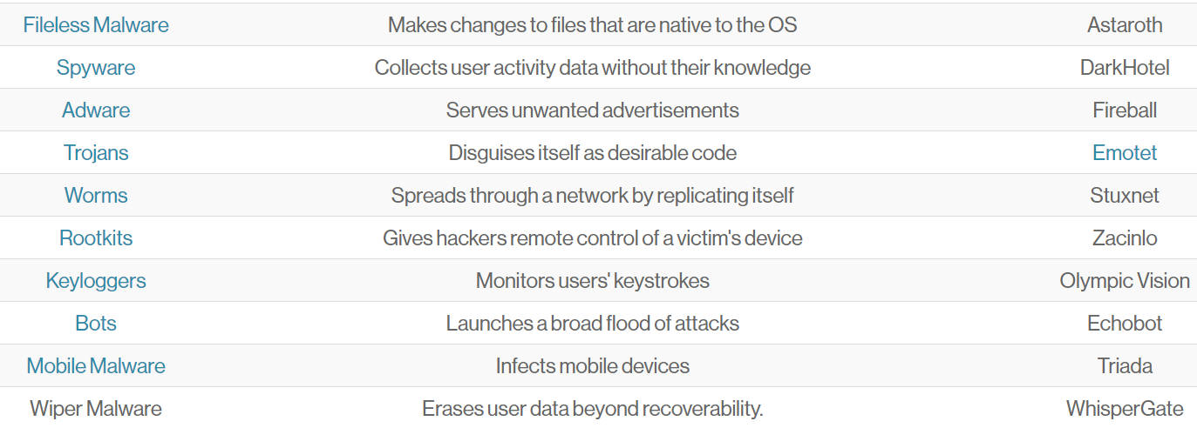

Slide 20
malware
Each type of malware has unique characteristics and methods of infection. These malicious programs can wreak havoc on computer systems by exploiting software vulnerabilities, spreading through malicious downloads, or disguising themselves as legitimate software to gain access to sensitive data and resources.
The methods used to spread malware are constantly evolving, making it increasingly challenging to detect and remove these threats. We will now examine each of these common types of malware, exploring their specific traits and infection strategies.

Slide 21
Viruses
Viruses are self-replicating code that infects applications and can cause data theft, DDoS attacks, or ransomware attacks. They propagate by modifying other computer programs, inserting their malicious code and executing it on the victim’s device. Despite numerous antivirus software available to counteract their effects, viruses continue to plague computer systems across the globe, targeting various operating systems such as Microsoft Windows and Mac.
Keeping your operating system and applications up to date is the optimal way to protect yourself from viruses.

Slide 22
Worms
Worms are standalone programs that spread rapidly and can execute payloads to damage systems, such as deleting files or creating botnets. Unlike viruses, worms typically cause damage to a network, even if only by consuming bandwidth. They propagate through computer networks by exploiting vulnerabilities or security flaws on the target computer to gain access.
Despite the absence of a payload, payload-free worms can still have a significant impact on network traffic.

Slide 23
Fileless Malware
Fileless malware doesn’t install anything initially, instead, it makes changes to files that are native to the operating system, such as PowerShell or WMI.
Because the operating system recognizes the edited files as legitimate, a fileless attack is not caught by antivirus software — and because these attacks are stealthy, they are up to ten times more successful than traditional malware attacks.

Slide 24
Trojan Horses
Taking their name from the huge wooden horse in which the Greeks hid to get inside the ancient city of Troy, these are among the sneakiest of computer viruses.
Used by cyber-criminals, Trojan horses are disguised as normal programs, tempting you to install them on your computer.
Once installed, the viruses gain access to your computer's files and capture your private data – think passwords and online banking information.
This can then be used by hackers to make online purchases with your bank account or expose your private information.

Slide 25
Trojans
Trojans masquerade as legitimate software to trick users into downloading malicious software, which can be used to:
Capture data
Gain unauthorized access to networks
Delete, modify, or capture data
Harvest a device as part of a botnet
Spy on a device
Typically spread through social engineering tactics, such as phishing, trojans can pose a serious threat to your security.
The payload of a trojan usually consists of a backdoor that provides the attacker with unauthorized access to the infected computer. This can potentially grant access to personal information, including:
Internet activity
Banking login credentials
Passwords
Personally Identifiable Information (PII)

Slide 26
Adware
Adware displays unwanted ads, tracks user activity, and can be managed through pop-up controls or ad-blockers. While not all adware is malicious, the risks associated with adware include the potential for a user’s privacy to be compromised, as data captured by adware is often collated with data collected from other sources and used to create a profile of the user without their consent.
Fireball is an example of adware which is said to have infected around 250 million devices. It does this by hijacking the browser and tracking each user’s web activity..
To manage adware, users can adjust the pop-up controls and preferences within their internet browsers or utilize an ad blocker.

Slide 27
Spyware
Spyware steals sensitive information and can spread through software vulnerabilities or legitimate software downloads. This type of malware collects information about users’ activities without their knowledge or consent, such as:
Internet activity
Banking login credentials
Passwords
Personally Identifiable Information (PII)
Phishing, social engineering and malicious downloads are the common ways to introduce spyware into a system.
This type of software can cause harm to user’s data and privacy. Among the various types of spyware, keyloggers record user activity, potentially acquiring password data, financial data, and other confidential information.

Slide 28
Rootkits
Rootkits are a type of stealthy malware that subtly embeds themselves within a computer’s core, eluding conventional security scans and anti-malware programs. These insidious software entities employ intricate techniques to obscure their existence, making it extremely difficult for detection. Once entrenched, rootkits facilitate unauthorized access, allowing cybercriminals to take control of the compromised system.
They can manipulate system functions and processes, concealing their presence and making them an ideal tool for various malicious activities like data theft, keystroke logging, remote control, and creating secret backdoors. Rootkits provide attackers with the means to compromise system integrity and maintain prolonged, surreptitious access, all while evading detection by both human and AI-driven security mechanisms.

Slide 29
Keyloggers
Keyloggers are discreet software or hardware components designed to surreptitiously record a user’s keystrokes without their knowledge or consent. These covert tools operate in the background, capturing every keystroke made on a targeted device, including usernames, passwords, and sensitive information.
Keyloggers can silently transmit this harvested data to malicious actors, allowing them to gain unauthorized access to personal accounts, confidential information, or even financial assets.
Because of their clandestine nature, keyloggers pose a significant security threat, enabling cybercriminals to compromise privacy and exploit the captured data for fraudulent activities while avoiding detection by security measures.

Slide 30
Macro Virus
This type of computer virus is normally found in Microsoft Office programs. Word and Excel files are favorite places for macro viruses to embed themselves. Like most other viruses (except spacefillers – more on these later) macro viruses increase the size of files when they infect them, as they attach their own code. Once a macro virus infects a file, it can easily spread to other computers when that file is shared, for example via email.

Slide 31
Boot Sector Virus
Much like beepers and Tamagotchis, boot sector viruses are terrible little things that were big in the 90s. One of the oldest types of viruses, boot sector viruses go straight for the core of your computer, affecting the startup or ‘boot’ process. Back in the day, these viruses were spread through floppy disks. Nowadays, they attach themselves to emails or USB sticks. If your computer catches one of these, you’ll need an expert to carry out a full system reformat (Windows, Mac).

Slide 32
Overwrite Virus
When it comes to pests, these take first prize. Overwrite viruses typically take over a file and wipe the original code without you even knowing it. Once deleted, the original files cannot be recovered and the data is lost. They often spread through emails via attachments or through file downloads on the internet, so always scan files with an anti-virus software before downloading and opening them. This will help you detect these viruses before they even have a chance to cause problems.

Slide 33
Browser Hijacker
The digital equivalent of a crooked cold-caller salesman, browser hijackers take over your internet searches and redirect you to pages you didn’t even want to visit. While not as harmful as other types of viruses – they trick you rather than steal from you – browser hijackers are still an annoying problem since they significantly lower your UX when surfing the internet. If you experience lots of random pop-up adverts or your usual homepage browser has changed without you telling it to, chances are you’ve got a browser hijacker. Always scan email attachments before opening and avoid downloading files from suspicious websites to avoid browser hijackers.

Slide 34
Web Scripting Virus
This is one for the modern age. Web scripting viruses are very clever little bugs that blend into the background of popular websites – usually social media platforms. They disguise themselves as normal links, tempting you to click on them. Then, like a greedy schoolyard bully, they steal your cookies. Ok, different cookies – we’re talking the kind of cookies that store your information. Still, web scripting viruses definitely shouldn’t be taken lightly – they can send spam to your system and damage your data, and can spread faster than most viruses.

Slide 35
Polymorphic Virus
This is one sly virus. Like a chameleon changing its color for every situation, a polymorphic virus modifies whenever it replicates. This makes it hard for most anti-virus programs to keep up. Once it’s found its way onto your computer – usually through an email attachment or a download from a suspicious website – it has free reign to delete your files, steal your data, and generally sabotage your system. The bad news is these shape-shifting charlatans are on the rise. The good news is that the top antivirus programs are starting to adapt alongside them, using more sophisticated scanning techniques to catch these chameleons in the act.

Slide 36
Resident Virus
One of the most common types of virus you’ll (hopefully not) come across, these sneaky little squatters find their way into your computer’s memory, completely uninvited, and make themselves at home. Just think of your old flatmate’s annoying friend who would invite themself over every night and steal your Ben and Jerry’s from the fridge. Resident viruses can come from email attachments, infected downloads or shared files and are then activated whenever your computer performs a specific action and can even attach themselves to anti-virus software, scamming the very thing that’s tasked with bringing it down. The best solution? Get an expert involved.

Slide 37
Multipartite Virus
Sometimes called ‘multi-part viruses’ these flexible fiends are on the rise. While most viruses either attack a computer’s central boot sector or through its files, a multipartite can do both. A versatile virus is hard to prevent, which explains the rapid growth rate of multipartite in recent years. They usually spread through .exe files – so programs like Word and Excel. How do you know if your computer is infected with a multipartite virus? Well, these viruses eat up your virtual memory like nothing else, so expect lots of ‘your computer has low virtual memory’ messages and a sudden slowing down of your computer.

Slide 38
Spacefiller Virus
Also known as ‘‘cavity viruses’, spacefiller viruses find the empty spaces in a program code and climb right in by adding their own code. This way, they don’t alter the size of files (as other viruses do), which makes them very hard to detect. Most antivirus programs find it hard to catch spacefillers, but there are a few manual virus-hunting tools that tech experts use to root them out. Thankfully, they’re not only hard to detect, but they’re also hard to create and there aren’t many file types that they can attach to. This makes spacefiller viruses very rare.

Slide 39
Phishing
Phishing is a malicious activity in which attackers impersonate reputable entities or individuals to obtain sensitive information or install malware. Typically occurring through:
email
text messages
phone calls
other forms of communication
Phishing is widely used as a delivery mechanism for malware attacks.
To protect against phishing, users should be mindful of the signs of a phishing attack, such as suspicious emails or links, and exercise caution when clicking on links or downloading attachments.

Slide 40
Torrents
Torrents are a method of distributing files over the internet using the BitTorrent protocol. Using torrents can lead to the distribution of malicious software, including viruses, worms, and Trojans, and potentially subject users to copyright infringement if they download copyrighted material.
To protect against malicious torrents, users should employ a reputable antivirus program to scan downloaded files for malicious software and only obtain torrents from reliable sources.

Slide 41
Malicious Websites
Malicious websites are created by cybercriminals with the aim of:
Stealing data
Infecting devices with malware
Installing dangerous software
Collecting confidential information
Interfering with computer operations
To ensure the security of your computer system, it is recommended to:
Employ antivirus software
Keep your operating system and software up-to-date
Exercise caution when clicking on links or downloading files from unknown sources.

Slide 42
How to Avoid and Lessen the Impact of Viruses
Use a firewall: A firewall is your computer’s first line of defense. While an antivirus program (more on that later) is active in your computer, detecting and neutralizing viruses, a firewall sits between your computer and the internet, swatting them away. Your computer normally comes with a pre-installed firewall – make sure it’s enabled.
Don’t click on suspicious links or pop-ups: The first one should be the most obvious. But so many people get suckered into clicking on dubious links on the internet. Ok, so we’ve all been tempted to click on a ‘12 Hollywood Actors Who Have Really Let Themselves Go’ link – especially when number 9 will “literally make your jaw drop.” Sometimes we all have to learn the hard way. But the golden rule is, if you don’t know or trust the website, proceed with caution. And always use a pop-up blocker.
Don’t open email attachments or links you aren’t sure about
Backup your files: Just imagine losing your most valued documents, photos, videos, etc. Almost unthinkable, right? That’s why, in the event that a virus gets through, it makes sense to have your data backed up. Make a copy of everything and store it on an external hard drive, as well as another computer, if possible.
Update your operating system: You know those annoying little update messages that pop up at the most inconvenient time? Well, it’s time to stop ignoring them. Whether you’re on a Mac or a PC, it’s crucial to keep your operating system up to date. Developers are constantly adding new improvements, many of which will help keep your computer free from viruses.

Slide 43
What is Antivirus?
Antivirus software is a program that searches for, detects, prevents, and removes software infections that can harm your computer.
Antivirus can also detect and remove other dangerous software such as worms, adware, and other dangers.
This software is intended to be used as a preventative measure against cyber dangers, keeping them from entering your computer and causing problems. Antivirus is available for free as well.
Anti-virus software that is available for free only provides limited virus protection, whereas premium anti-virus software offers more effective security. For example Avast, Kaspersky, etc.

